Slide 1
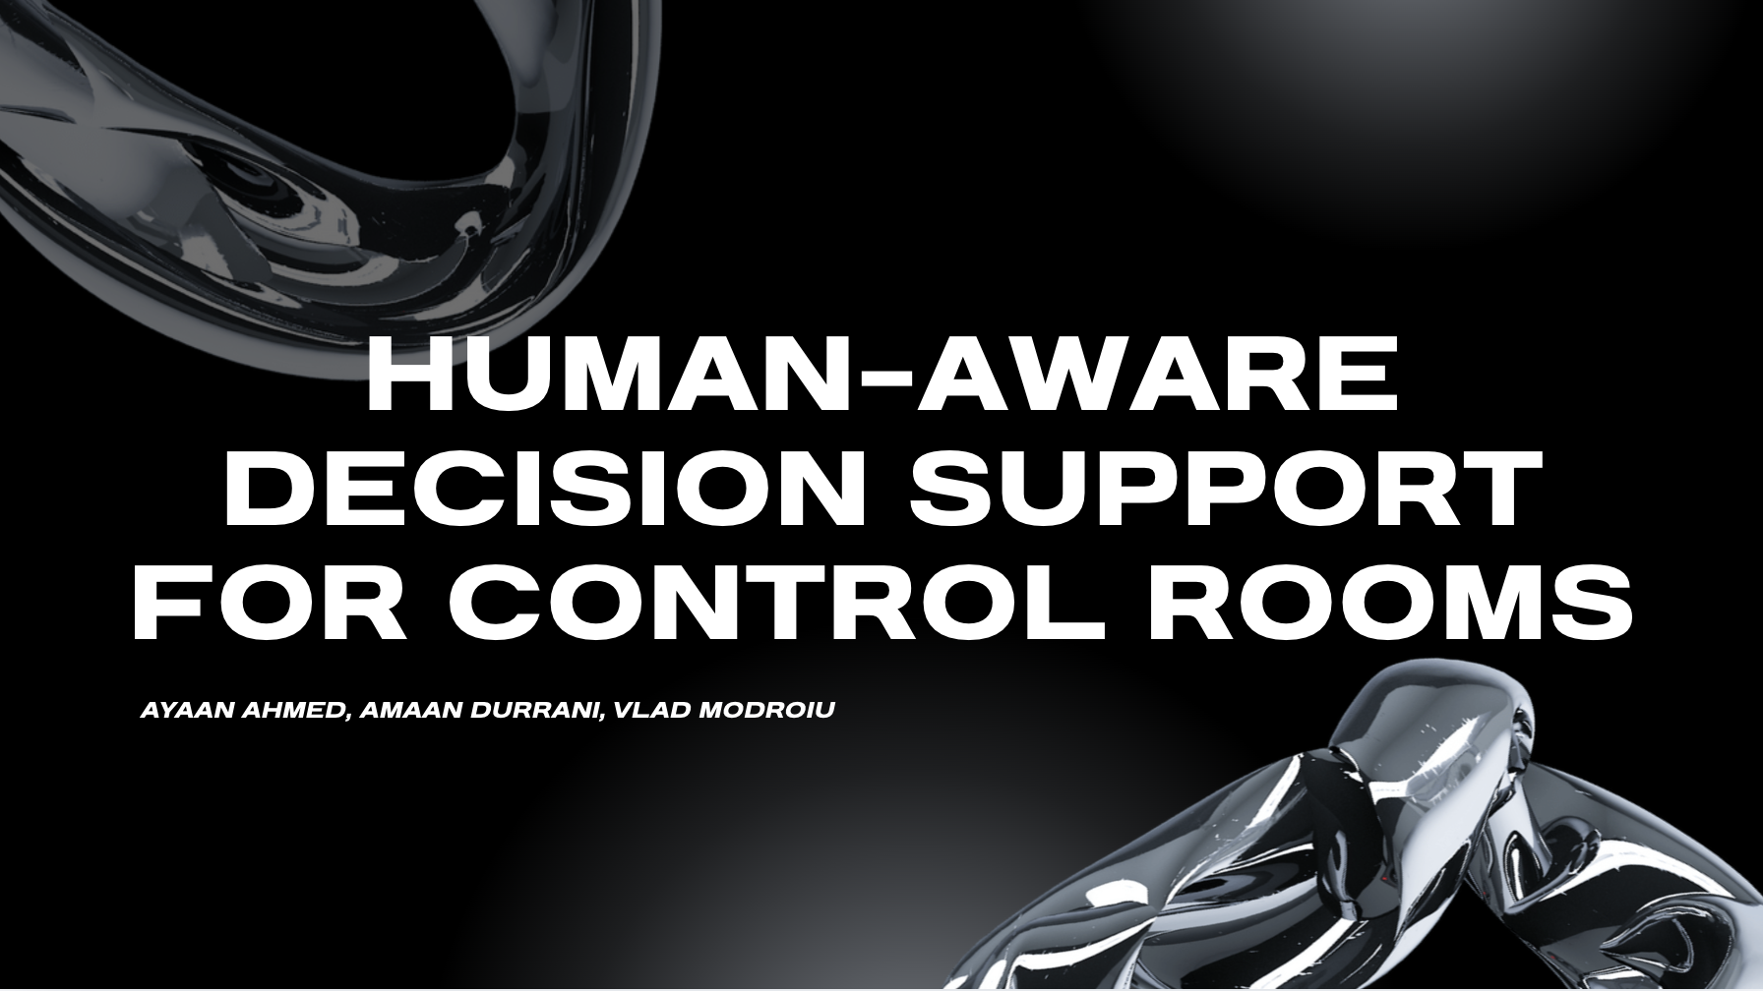

AI CASE COMPETITION
Human-Aware Decision Support for Control Rooms
Decision Support for Nuclear Control Rooms
6-Subsystem Proof-of-Concept • Human-in-Command Design
Human-Aware AI Safety Gate
1 / 7

Slide 2

Topic 1
Design new techniques, methods, and automated systems to improve human performance with control room design for nuclear power plants using digital twins, including enhanced human monitoring and decision support functions. Demonstrate a developed solution with test scenarios.
Human-Aware AI Safety Gate
1 / 7

Slide 3
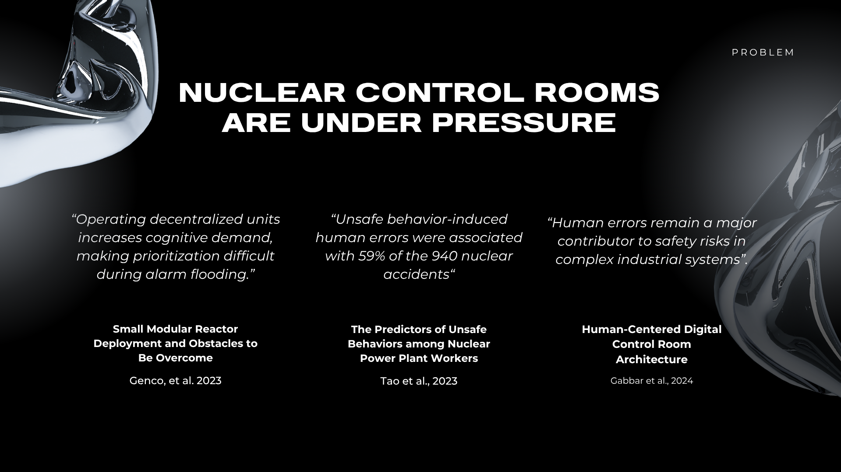



THE PROBLEM
Nuclear Control Rooms Are Under Pressure
Stress degrades decisions
Time pressure compounds errors
Even trained operators are affected
Context-Blind AI
Alarm Flooding
Cognitive Overload
Recommends without context
Ignores operator readiness
No awareness of compound risk
Simultaneous alerts all at once
Critical signals lost in noise
Operators can't prioritize
Human-Aware AI Safety Gate
2 / 7

Slide 4
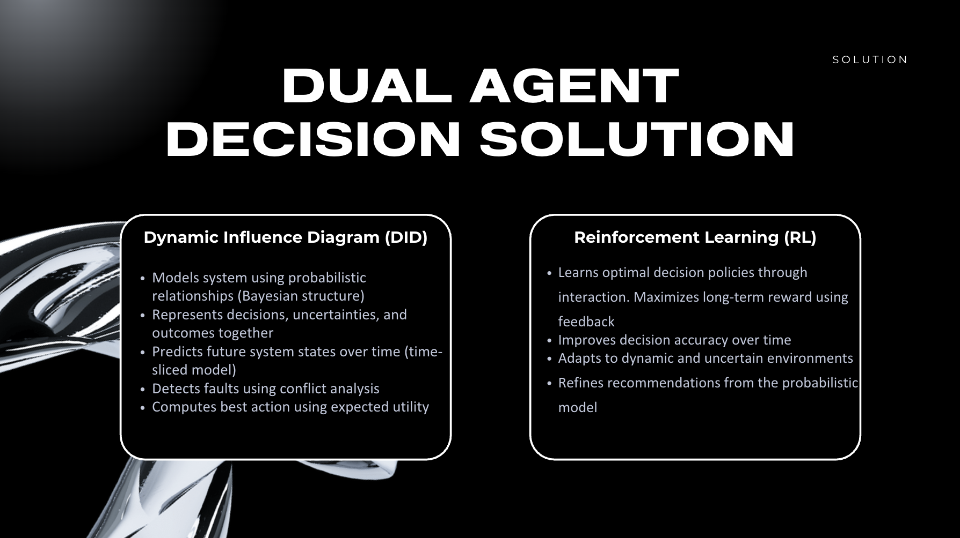
OUR SOLUTION
A 6-Subsystem Human-Aware Architecture
S1
Digital Twin
S2
Human Monitoring
S3
Situation Assessment
Predicts near-term plant behavior
Tracks operator workload & attention
Combines plant risk + human state
S4
Decision Support
S5
Adaptive Interface
S6
Scenario Evaluation
Dual-agent gate - core innovation
Adjusts display to cognitive load
Compares strategies & outcomes
Human-Aware AI Safety Gate
3 / 7

Slide 5
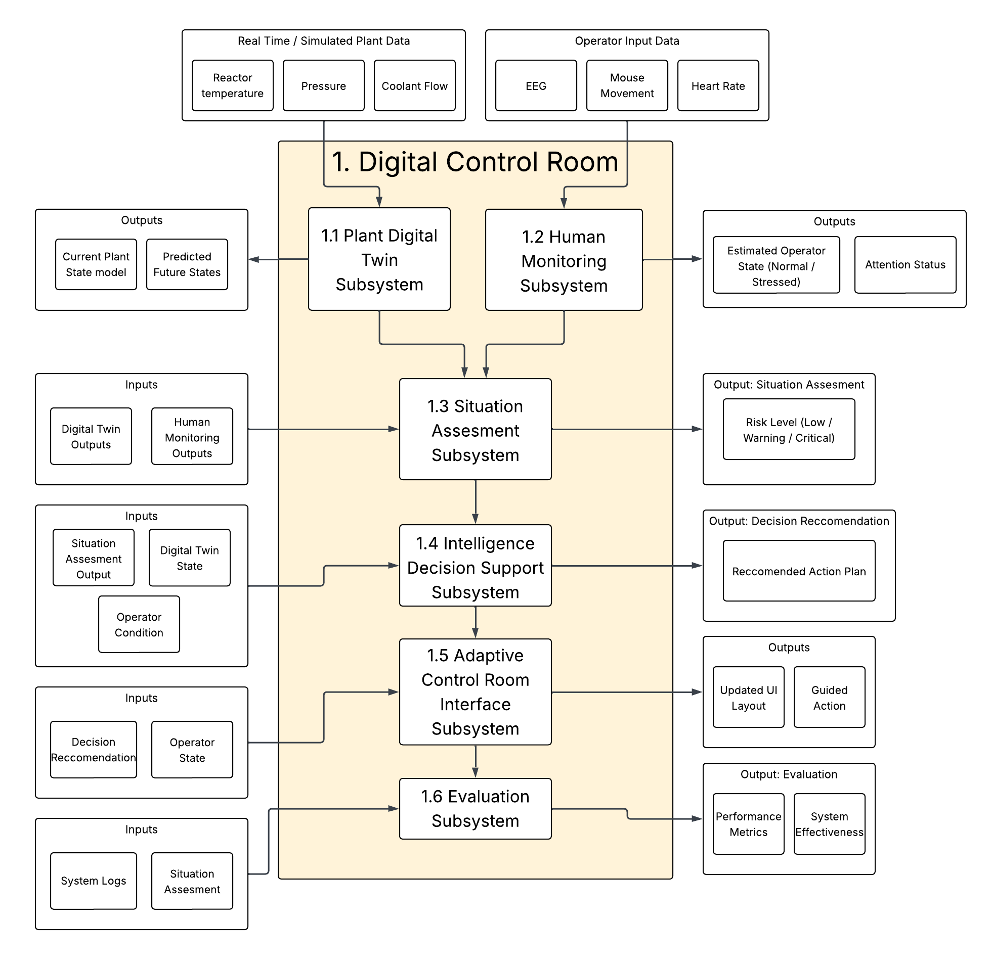
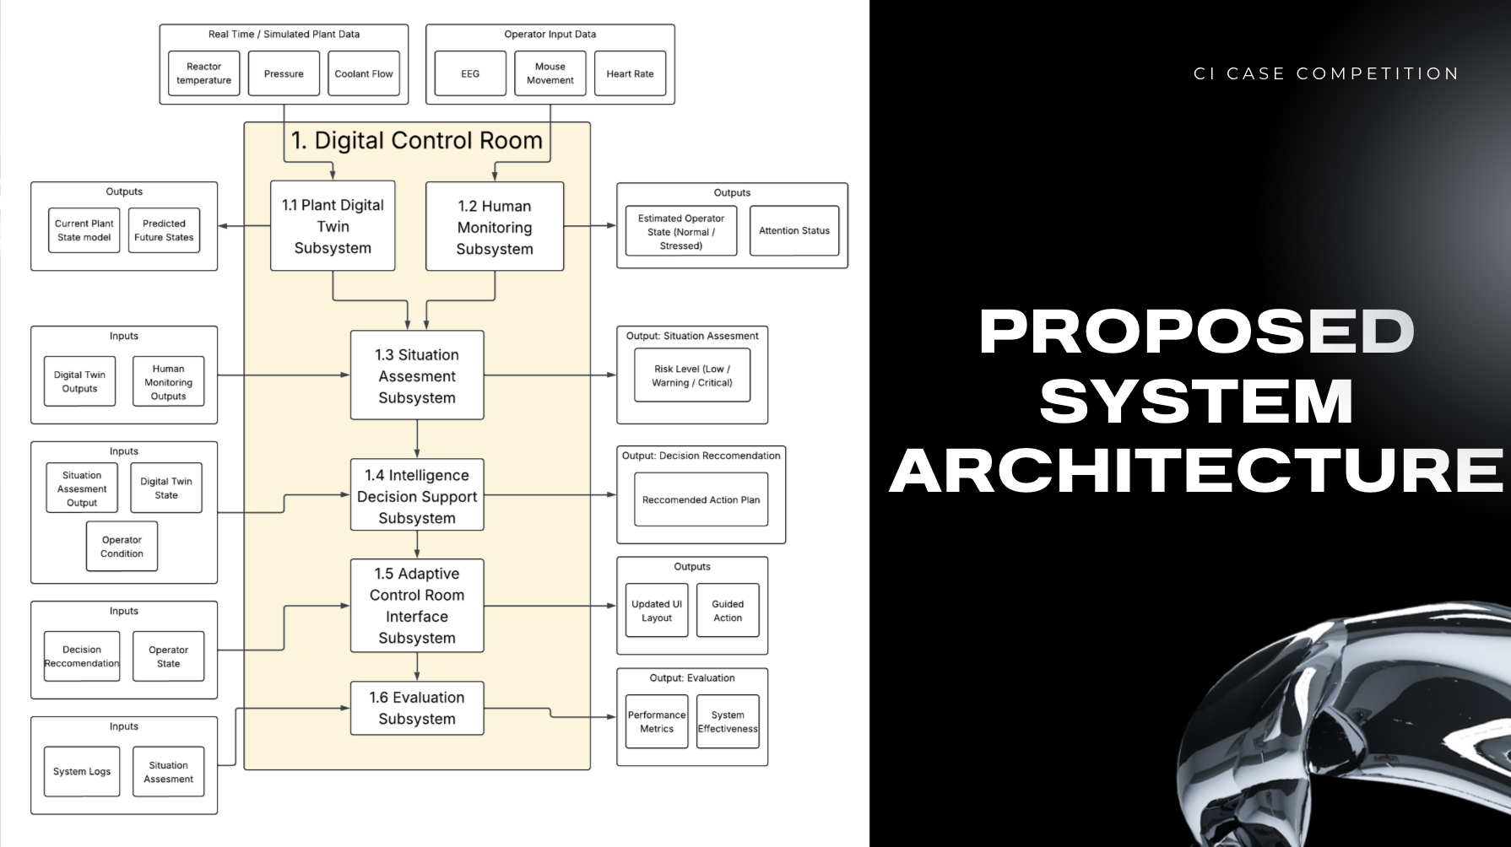
ARCHITECTURE
Proposed System Architecture
4 / 7

Slide 6
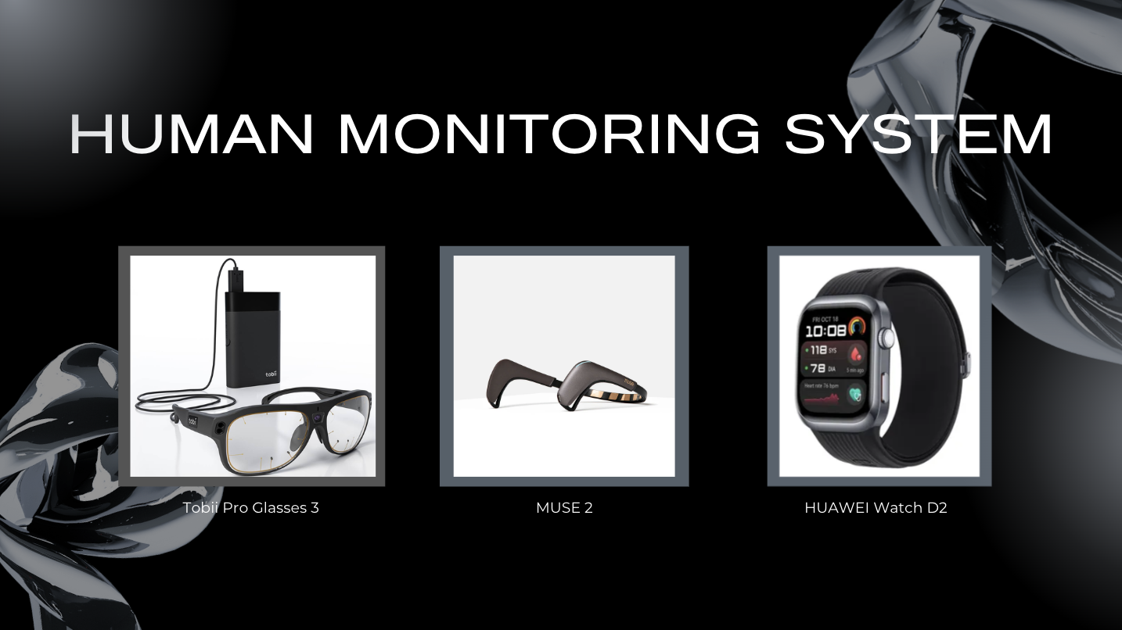
OUR SOLUTION
Dual Agent Decision Solution
Dynamic Influence Diagram (DID)
Reinforcement Learning (RL)
Models system using probabilistic relationships (Bayesian structure)
Represents decisions, uncertainties, and outcomes together
Predicts future system states over time (time-sliced model)
Detects faults using conflict analysis
Computes best action using expected utility
Learns optimal decision policies through interaction
Maximizes long-term reward using feedback
Improves decision accuracy over time
Adapts to dynamic and uncertain environments
Refines recommendations from the probabilistic model
Human-Aware AI Safety Gate
3 / 7

Slide 7
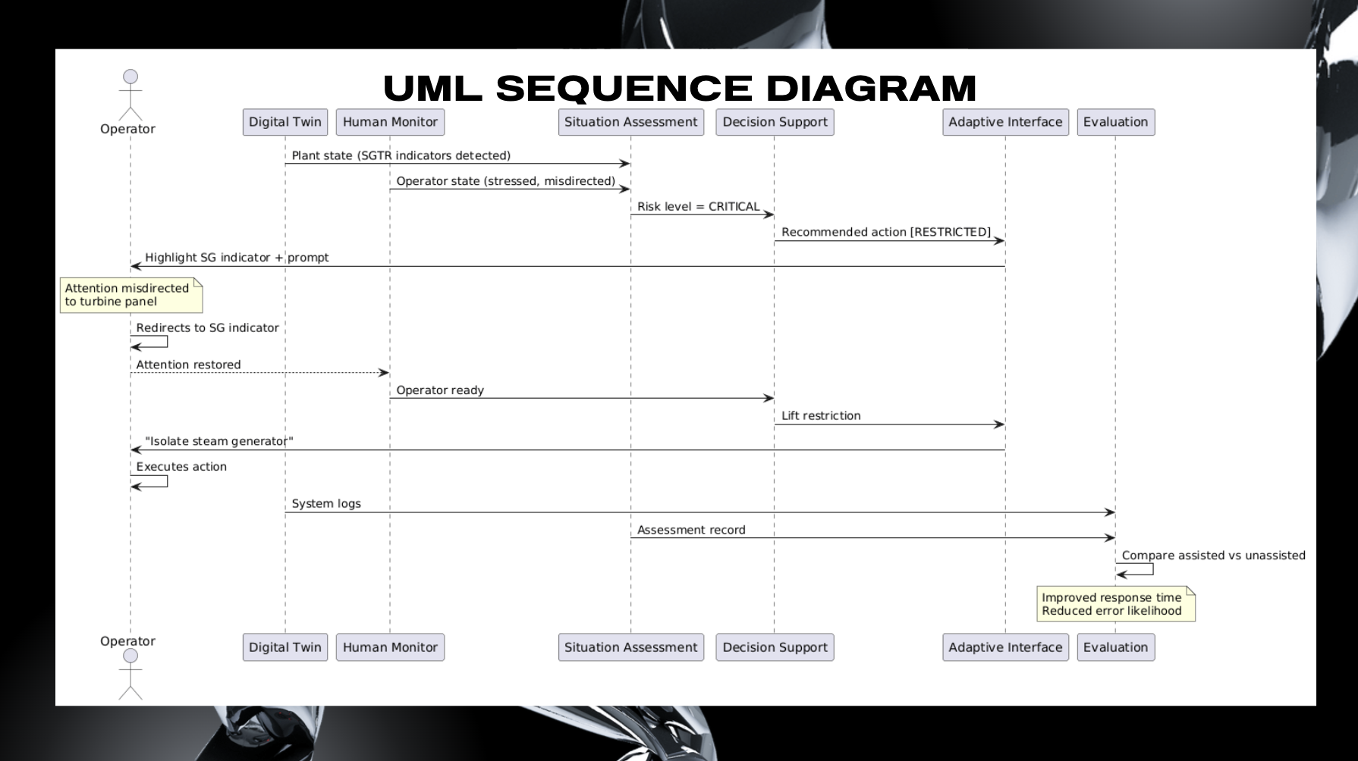
DEMO SCENARIO
Tube Rupture
S1
Digital Twin detects fault
Steam generator level rising • Pressure imbalance detected • Possible tube leak
S2
Human monitoring flags: operator overload
High alarm load • Delayed response • Fixated on wrong panel → Workload: HIGH
S3
Situation Assessment
Leak indicators + operator overload → Combined risk: HIGH
S4
Intelligence Decision support
Proposed: Isolate steam generator
BLOCKED — operator not ready + action requires verification
S5
Adaptive Interface guides next step
Focuses display on key gauge • Dims irrelevant panels • Prompts: “Verify this first”
Human-Aware AI Safety Gate
5 / 7

Slide 8

RESULTS & ANALYSIS
Results & Analysis
juuh
Safety Gate Advantage Dual-agent system ensures actions only happen when operator + system are aligned
Automation Bias Prevention 100% gating when operator overloaded, forces verification before action
Cognitive Resiliency Shifts operator from symptom-fixation, root-cause decision making
6 / 7

